Slide 1
Booting process
By
Bharath Kumar
Sahil Chaudhary
Aritra Sinha Roy
Titli Ghosh
Aakash Kulthia
Siddhesh Khedkar

Slide 2
What is Linux
Open-source Operating System (based on Unix, created by Linus Torvalds in 1991)
Core = Kernel → manages CPU, memory, devices
Free, Secure, Stable, and Customizable
Runs Everywhere → servers, mobiles (Android), supercomputers, IoT, desktops
Popular Distros → Ubuntu, Fedora, Debian, CentOS

Slide 3
Why linux over others?
✅ Open Source & Free
No costly licenses (unlike Windows & macOS).
Anyone can modify and redistribute.
✅ Security & Stability
Strong user permission model → less malware/viruses.
Rarely crashes; can run for years without reboot.
✅ Performance
Lightweight & efficient → works on old PCs, servers, and even supercomputers.
Better resource management than Windows.
✅ Flexibility & Customization
Choose from 100+ distros (Ubuntu, Fedora, Arch, etc.) based on need.
Full control over UI, system tools, and kernel.
✅ Servers & Cloud Dominance
~90% of cloud servers run Linux (AWS, Google Cloud, Azure).
Preferred for DevOps, AI/ML, networking, and containers (Docker, Kubernetes).
✅ Developer Friendly
Native support for programming languages, compilers, and tools.

Slide 4
User statistics
Area | Key Figures & Trends
Desktop / Personal Computers | Linux holds about 2–4% of the global desktop OS market share. (Tom's Hardware) In the US, Linux recently broke 5% market share in desktops. (TechSpot)
Web Servers | ~ 96.3% of the top 1 million web‐servers run Linux. (TrueList)
Supercomputers | ~ 91.5% of the world’s fastest supercomputers run Linux. (Coolest Gadgets)
Smartphones / Mobile | About 85% of smartphones use Android, which is based on the Linux kernel. (Enterprise Apps Today)
Developer / Enterprise Use | ~ 47% of professional developers use Linux. (Enterprise Apps Today) Linux is used by ~ 84-85% of enterprise businesses in various capacities. (Enterprise Apps Today)
Browser / OS Market Trends | Linux has been slowly increasing in desktop share; reached ~ 4.03% globally in early 2024. (Ars Technica)

Slide 5
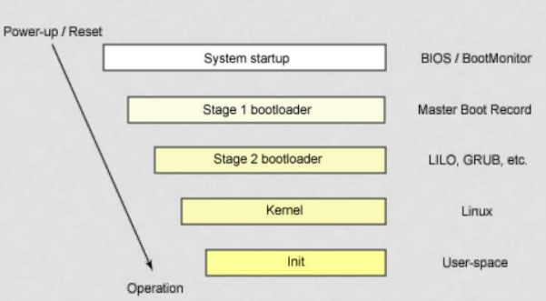
How Linux Boots?

Slide 6
SYSTEM STARTUP

Slide 7
HOW COMPUTER STARTUP ?
Booting is a bootstrapping process that starts operating systems when the user turns on a computer system
A boot sequence is the set of operations the computer performs when it is switched on that load an operating system

Slide 8
BOOTING SEQUENCE
Turn on
CPU jump to address of BIOS (OxFFFFO)
BIOS runs POST (Power-On Self Test)
Find bootale devices
Loads and execute boot sector form MBR
Load OS

Slide 9
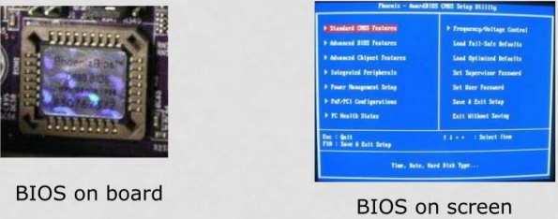
BIOS (BASIC INPUT/OUTPUT SYSTEM)
BIOS refers to the software code run by a computer when first powered on
The primary function of BIOS is code program embedded on a chip that recognises and controls various devices that make up the computer.

Slide 10
BOOT LOADER

Slide 11
MBR (MASTER BOOT RECORD)
OS is booted from a hard disk, where the Master Boot Record (MBR) contains the primary boot loader
The MBR is a 512-byte sector, located in the first sector on the disk (sector 1 of cylinder 0, head 0)
After the MBR is loaded into RAM, the BIOS yields control to it.

Slide 12
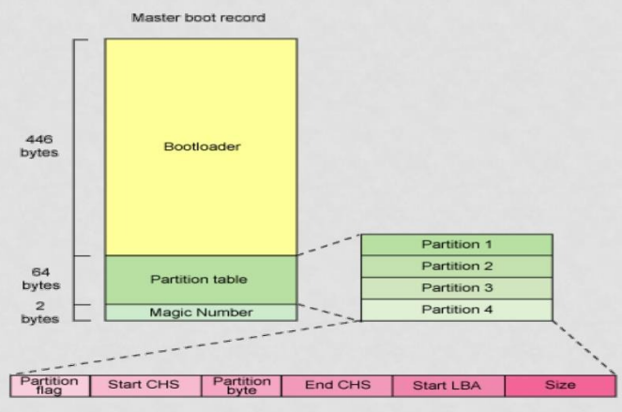
MBR (MASTER BOOT RECORD)

Slide 13
MBR (MASTER BOOT RECORD)
The first 446 bytes are the primary boot loader, which contains both executable code and error message text
The next sixty-four bytes are the partition table, which contains a record for each of four partitions
The MBR ends with two bytes that are defined as the magic number (0xAA55).
The magic number serves as a validation check of the MBR

Slide 14
EXTRACTING THE MBR
To see the contents of MBR, use this command:
# dd if=/dev/hda of=mbr.bin bs=512 count=1
# od-xa mbr.bin
The dd command, which needs to be run from root, reads the first 512 bytes from /dev/hda (the first Integrated Drive Electronics, or IDE drive) and writes them to the mbr.bin file.
The od command prints the binary file in hex and ASCII formats.

Slide 15
BOOT LOADER
Boot loader could be more aptly called the kernel loader.
The task at this stage is to load the Linux kernel Optional, initial RAM disk
GRUB and LILO are the most popular Linux boot loader

Slide 16
OTHER BOOT LOADER (SEVERAL OS)
bootman
GRUB
LILO
NTLDR
XOSL
BootX
loadlin
Gujin
Boot Camp
Syslinux
GAG

Slide 17
GRUB: GRAND UNIFIED BOOTLOADER
GRUB is an operating system independant boot loader
A multiboot software packet from GNU
Flexible command line interface
File system access
Support multiple executable format
Support diskless system
Download OS from network Etc.

Slide 18
GRUB BOOT PROCESS
The BIOS finds a bootable device (hard disk) and transfers control to the master boot record 2. The MBR contains GRUB stage
Given the small size of the MBR, Stage 1 just load the next stage of GRUB
GRUB Stage 1.5 is located in the first 30 kilobytes of hard disk immediately following the MBR. Stage 1.5 loads Stage
GRUB Stage 2 receives control, and displays to the user the GRUB boot menu (where the user can manually specify the boot parameters).
GRUB loads the user-selected (or default) kernel into memory and passes control on to the kernel.

Slide 19
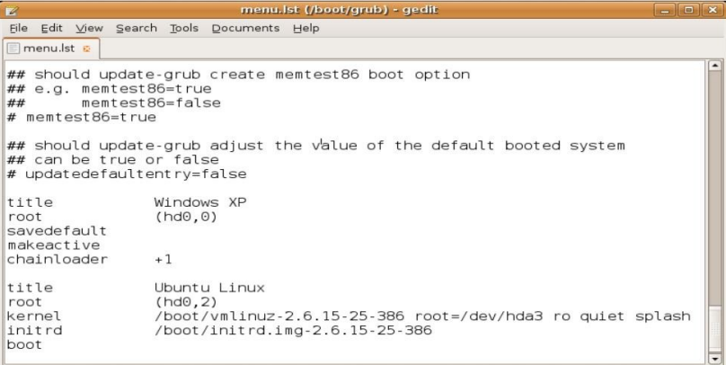
EXAMPLE GRUB CONFIG FILE

Slide 20
LILO: LINUX LOADER
Not depend on a specific file system
Can boot from harddisk and floppy
Up to 16 different images
Must change LILO when kernel image file or config file is changed

Slide 21
KERNEL

Slide 22
KERNEL IMAGE
The kernel is the central part in most computer operating systems because of its task, which is the management of the system's resources and the communication between hardware and software components
Kernel is always store on memory until computer is turned off
Kernel image is not an executable kernel, but a compress kernel image
zlmage size less than 512 KВ
bzlmage size greater than 512 KB

Slide 23
TASK OF KERNEL
Process management
Memory management
Device management
System call

Slide 24
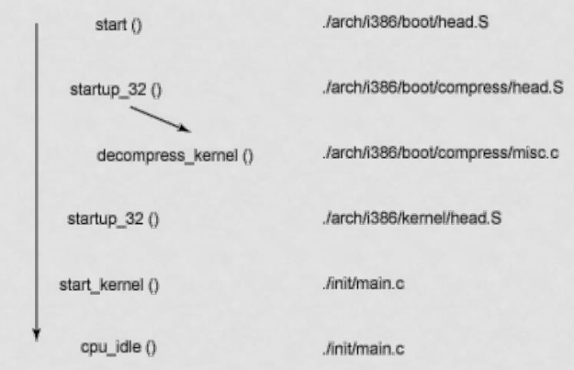
MAJOR FUNCTIONS FLOW FOR LINUX KERNEL BOOТ

Slide 25
INIT PROCESS
The first thing the kernel does is to execute
Init program Init is the root/parent of all processes executing on LinuX
The first processes that init starts is a script /etc/rc.d/rc.sysinit
Based on the appropriate run-level, scripts are executed to start various processes to run the system and make it functional

Slide 26
THE LINUX INIT PROCESSES
The init process is identified by process id "1"
Init is responsible for starting system processes as defined in the /etc/inittab file
Init typically will start multiple instances of "getty" which waits for console logins which spawn one's user shell process
Upon shutdown, init controls the sequence and processes for shutdown

Slide 27
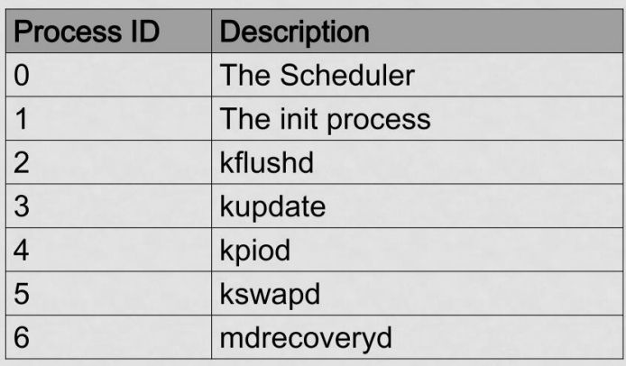
SYSTEM PROCESSES

Slide 28
INITTAB FILE
The inittab file describes which processes are started at bootup and during normal operation
/etc/init.d/boot
/etc/init.d/rc
The computer will be booted to the runlevel as defined by the initdefault directive in the /etc/inittab file
id:5:initdefault:

Slide 29
RUNLEVELS
A runlevel is a software configuration of the system which allows only a selected group of processes to exist
The processes spawned by init for each of these runlevels are defined in the /etc/inittab file
Init can be in one of eight runlevels: 0-6

Slide 30
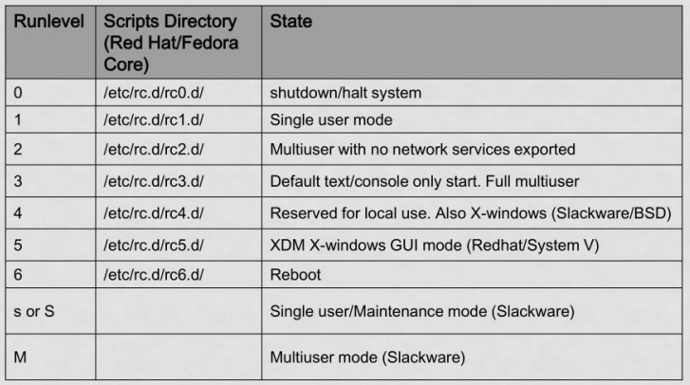
RUNLEVELS

Slide 31
RC#.D FILES
rc#.d files are the scripts for a given run level that run during boot and shutdown
The scripts are found in the directory /etc/rc.d/rc#.d/
where the symbol # represents the run level

Slide 32
INIT.D
Deamon is a background process
init.d is a directory that admin can start/stop individual demons by changing on it
/etc/rc.d/init.d/(Red Hat/Fedora)
/etc/init.d/ (S.u.s.e)
/etc/init.d/ (Debian)

Slide 33
START/STOP DEAMON
Admin can issuing the command and either the start, stop, status, restart or reload option
to stop the web server:
cd/etc/rc.d/init.d/ (or /etc/init.d/ for S.u.s.e. and Debian)
httpd stop

Slide 34
LINUX FILES STRUCTURE

Slide 35
FSSTND : (FILESYSTEM STANDARD)
All directories are grouped under the root entry "/" root
The home directory for the root user home –
Contains the user's home directories along with directories for services . .
ftp
HTTP
samba

Slide 36
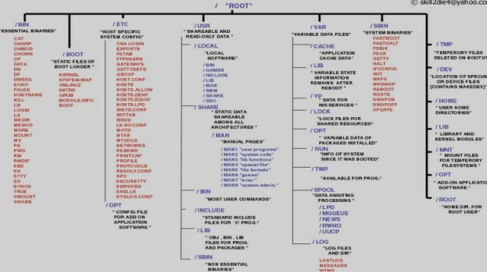
LINUX FILES STRUCTURE

Slide 37
FSSTND : (FILESYSTEM STANDARD)
bin - Commands needed during booting up that might be needed by normal users
sbin - Like bin but commands are not intended for normal users.
Commands run by LINUX.
proc - This filesystem is not on a disk. It is a virtual filesystem that exists in the kernels imagination which is memory .
1 - A directory with info about process number & 1 Each process has a directory below proc.

Slide 38
FSSTND: (FILESYSTEM STANDARD)
usr - Contains all commands, libraries, man pages, games and static files for normal operation.
. bin - Almost all user commands. some commands are in /bin or /usr/local/bin.
sbin - System admin commands not needed on the root filesystem. e.g., most server programs.
include - Header files for the C programming language. Should be below /user/lib for consistency.
lib - Unchanging data files for programs and subsystems
local - The place for locally installed software and other files. man - Manual pages
nfo - Info documents doc - Documentation
tmp
X11R6 - The X windows system files. There is a directory similar to usr below this directory.
X386 - Like X11R6 but for X11 release 5

Slide 39
FSSTND : (FILESYSTEM STANDARD)
boot - Files used by the bootstrap loader, LILO.
Kernel images are often kept here.
lib - Shared libraries needed by the programs on the root filesystem
modules - Loadable kernel modules, especially those needed to boot the system after disasters.
dev - Device files etc - Configuration files specific to the machine.
skel - When a home directory is created it is initialized with files from this directory
sysconfig - Files that configure the linux system for devices.

Slide 40
FSSTND : (FILESYSTEM STANDARD)
var - Contains files that change for mail, news, printers log files, man pages, temp files
. file
lib - Files that change while the system is running normally
local - Variable data for programs installed in /usr/local.
lock - Lock files. Used by a program to indicate it is using a particular device or file
log - Log files from programs such as login and syslog which logs all logins and logouts.
run - Files that contain information about the system that is valid until the system is next booted
spool - Directories for mail, printer spools, news and other spooled work.
tmp - Temporary files that are large or need to exist for longer than they should in /tmp. •
catman - A cache for man pages that are formatted on demand

Slide 41
SSTND : (FILESYSTEM STANDARD)
mnt - Mount points for temporary mounts by the system administrator.
tmp - Temporary files. Programs running after bootup should use /var/tmp

Slide 42
Thank You ☺

